Slide 1
K-MERS ANALYSIS TOOL group members: ALEENA FAIZYAB(FA21-BSI-003) EMAN FATIMA(FA21-BSI-012) SIDRA FAREED(FA21-BSI-042)

Slide 2

INTRODUCTION

Slide 3
INTRODUCTION
K-mer analysis plays a crucial role in DNA/RNA sequence analysis.
K-mer analysis is used in bioinformatics for sequence analysis, particularly in DNA, RNA, or protein sequences.
A K-mer is a substring of length K within a given sequence.
Application: It helps in tasks like genome assembly, sequence alignment, error correction, and detecting genomic patterns or motifs.
How it works: The tool breaks a sequence into smaller overlapping or non-overlapping subsequences of length K, counts the occurrences of each unique K-mer, and uses that information for various analyses (such as identifying conserved sequences).
Example: For a DNA sequence like "AGCTAGC", if K = 3, the K-mers would be "AGC", "GCT", "CTA", "TAG", "AGC", etc.

Slide 4
Agenda
Problem Statement:
Traditional bioinformatics tools often face challenges in handling multiple functionalities and lack of user-friendliness.
Accurate and efficient identification of k-mers from sequences is fundamental for tasks like genome assembly, error correction, and identifying biological markers.
How My Tool Solves These Problems:
My K-mer Analysis Tool is designed to be fast, user-friendly, and computationally efficient.
It automates the process of K-mer extraction, counting, and visualization with optimized algorithms.
Built to run on both small and large-scale genomic data, the tool improves accessibility and reduces computational bottlenecks.

Slide 5
Existing Tools and My Tool’s Differences
Existing Tools:
KmerGenie: Often used for genome assembly to find optimal k-mer lengths. While effective, it's computationally expensive.
Jellyfish: A fast K-mer counter but has limitations in usability and integration with other bioinformatics tools.
BBMap: Offers K-mer based alignment and analysis tools but is often complex to use for beginners and lacks customization.
How My Tool is Different:
Optimized for Efficiency: Focuses on faster processing of sequences with lower memory usage.
User-Friendly Interface: Unlike existing tools, my tool provides an intuitive command-line or GUI interface for both novice and expert users.
Customizable Output: Offers more flexibility in output formats, including CSV, JSON, and visualization options (e.g., graphs and heatmaps).
Scalability: Able to process datasets ranging from small genetic samples to large genomic data without significant performance hits.

Slide 6

Objectives

Slide 7
Key Objectives of My K-mer Analysis Tool:
Efficient K-mer Counting: Quickly counts the frequency of k-mers within a given sequence, making it useful for genome sequencing, metagenomics, and error detection.
Visualization: Generates graphs (e.g., histograms, frequency plots) to aid in the analysis and interpretation of K-mer frequencies.
Flexible Output: Provides multiple output formats for easy integration into other pipelines or research environments.
Scalability: Handles large genomic datasets with minimal memory usage, making it suitable for high-throughput sequencing applications.

Slide 8
Methods Libraries +Language

Slide 9
Programming Language & Libraries:
Language: Python, for ease of use and broad bioinformatics library support.
Libraries:
Biopython: For handling FASTA files and biological sequence analysis.
NumPy: For efficient numerical operations, especially in managing K-mer frequency data.
Matplotlib/Seaborn: For visualizing K-mer distributions in graphs.
Pandas: For organizing the K-mer frequency data and outputting in CSV/JSON formats.
argparse: For user-friendly command-line interface development.
Tkinter: For creating the GUI (Graphical User Interface). Modules: tk, filedialog, messagebox, ttk.

Slide 10
Code Functionalities:
Input Handling: The tool accepts FASTA/FA files and processes them into sequences.
K-mer Extraction: The tool splits sequences into overlapping k-mers of user-defined lengths.
Frequency Counting: It counts the occurrences of each k-mer and stores them in a dictionary or Pandas DataFrame.
Visualization:
Generate Phylogenetic Tree: Construct and visualize phylogenetic trees based on k-mer frequency or similarity data to infer evolutionary relationships.
Heat Map Generation: Include features for customization (e.g., color gradients, scaling, and clustering).
Efficient Memory Usage: Uses efficient data structures to minimize memory footprint.
Export Data: Facilitate the extraction and export of k-mer analysis results in standardized formats (e.g., CSV, TSV, or JSON) for downstream processing and sharing.

Slide 11
UML Diagram Activity Diagram

Slide 12


INPUT
User has a Fasta File?
OR wants to enter Sequence manually?
Manual Entry
Fasta File
Input DNA Sequence
Upload File
Enter K-mer Size
Perform K-mer Analysis
Generate Heatmap
Detect AMR Genes
Generate Phylogenetic Tree
Export Data as csv
OUTPUT

Slide 13
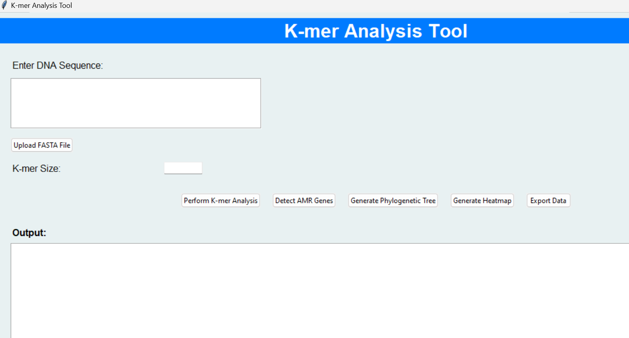
GUI INTERFACE

Slide 14
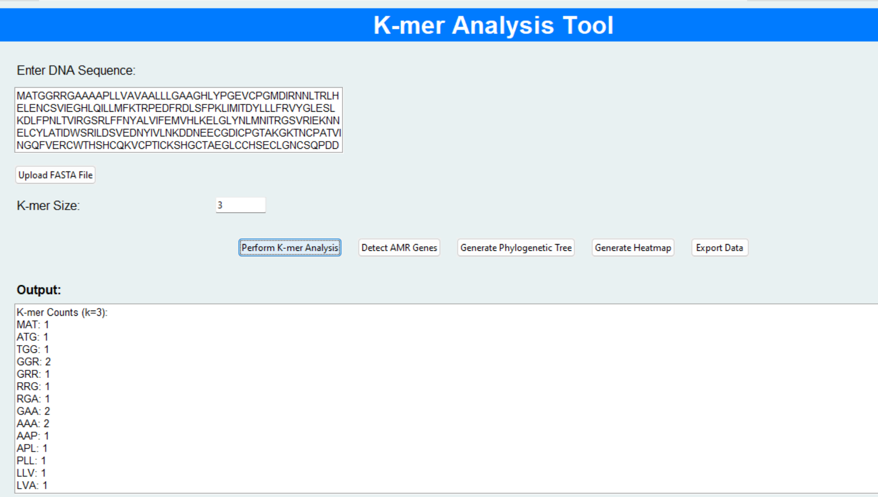
OUTPUT

Slide 15
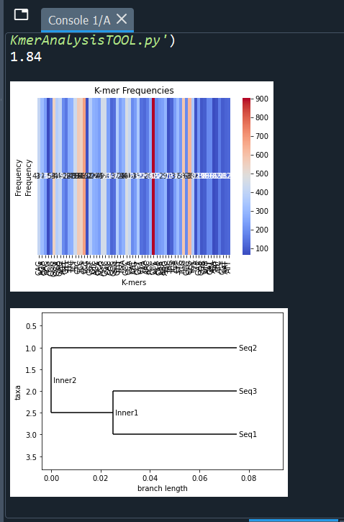

OUTPUT

Slide 16
Conclusion
The K-mer analysis tool simplifies the process of sequence analysis, making it more accessible and efficient.
Its key benefits include its user-friendly interface, scalability, flexibility, and faster processing capabilities.
With powerful visualization and customizable outputs, the tool is poised to make a significant impact in bioinformatics research.
feedback

Slide 17
Thank you

